Slide 1
PREDICTION OF INCIDENCE AND
SEVERITY OF COFFEE LEAF RUST
Under the guidance of
Prof. Chiranjit Mukhopadhyay
By:
Amitabh Gunjan
Organisation:
eka Analytics
Department of Management Studies 5th April 2018 Indian Institute of Science

Slide 2
AGENDA
Introduction
Recap (problem statement, data description)
VAR modelling
Interpretation from VAR output - Granger causality , impulse responses
Accuracy
Machine learning models – Motivation
Recurrent Neural Networks.
Long short term memory – LSTM
Road ahead
Department of Management Studies 5th April 2018 Indian Institute of Science

Slide 3
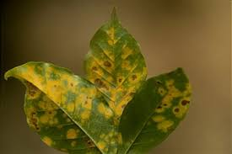
INTRODUCTION
Leaf rust:
caused by a fungus called Hemileia Vastatrix.
Leads to premature fall of infected leaves.
Symptoms include appearance of spots on the upper leaf surface of plants.
Impacts:
Decreased quality and quantity of yield produced.
Increased cost to control and combat the disease.
Key definitions:
Rust incidence: (Number of infected leaves/Total number of leaves observed)*100
Severity: (Sum of severity ratings of all observed leaves/(5* Total number of leaves observed))*100
Scale for grading of severity ranges from 0 to 5.
Department of Management Studies 5th April 2018 Indian Institute of Science

Slide 4
PROBLEM STATEMENT
DATA DESCRIPTION
Category | Description
Weather conditions | Average maximum temperature(◦c) Average minimum temperature(◦c) Relative humidity Sunshine(hours) Rainfall(mm)
Leaf rust | Population infected: (Number of plants infected/Total number of plants observed)*100 Rust incidence: (Number of infected leaves/Total number of leaves observed)*100 Severity: ((Sum of severity ratings of all observed leaves/5)* Total number of leaves observed)*100 *Scale for grading of severity ranges from 0 to 5.
Client of EKA analytics has coffee plantations which face the severe problem of leaf rust that leads to huge losses of yield.
The client had initiated an experimental trial on one of the plantations and recorded leaf rust incidence and severity on fortnightly basis over the span of 8 years.
They want forewarning model on the outbreak of disease.
The aim of this project is to predict coffee leaf rust incidence and severity.
Department of Management Studies 5th April 2018 Indian Institute of Science

Slide 5
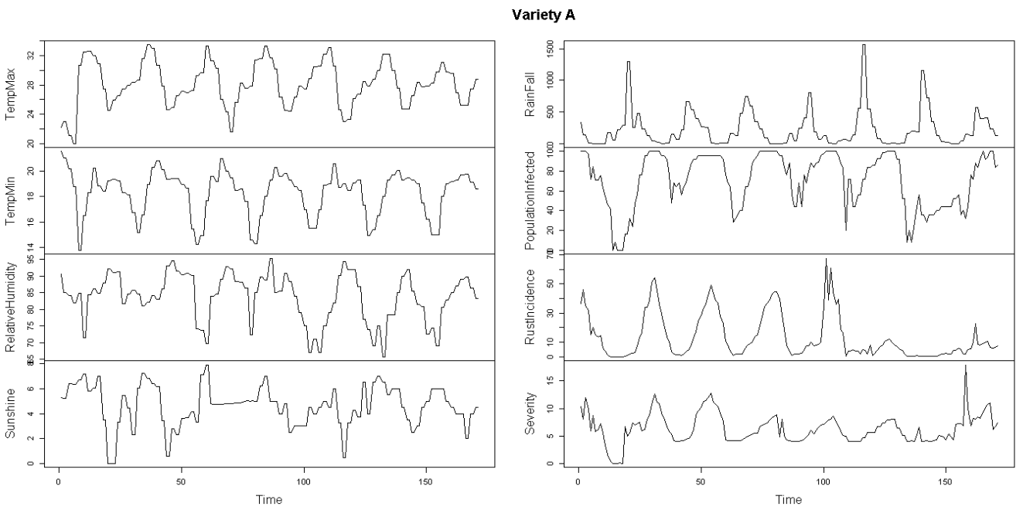
Time Series plots
Department of Management Studies 5th April 2018 Indian Institute of Science

Slide 6
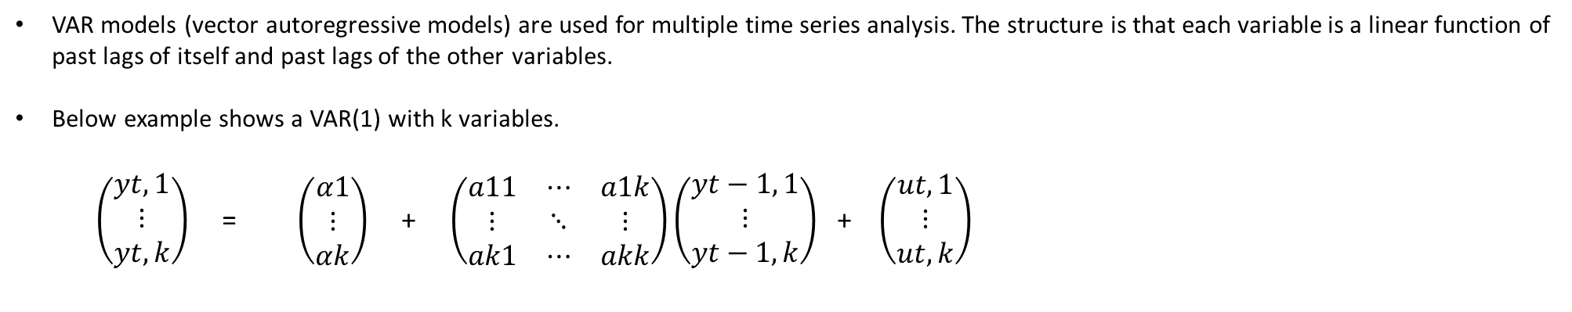
VAR MODELING
VAR models (vector autoregressive models) are used for multiple time series analysis. The structure is that each variable is a linear function of past lags of itself and past lags of the other variables.
Below example shows a VAR(1) with k variables.
$\left(\begin{aligned}yt,1 \\ ⋮ \\ yt,k\end{aligned}\right)$ = $\left(\begin{aligned}α1 \\ ⋮ \\ αk\end{aligned}\right)$ + $\left(\begin{matrix}a11 & ⋯ & a1k \\ ⋮ & ⋱ & ⋮ \\ ak1 & ⋯ & akk\end{matrix}\right)\left(\begin{aligned}yt−1, 1 \\ ⋮ \\ yt−1, k\end{aligned}\right)$ + $\left(\begin{aligned}ut,1 \\ ⋮ \\ ut, k\end{aligned}\right)$
In this case k = 8.
Order selection: Used the Schwartz criteria for VAR order selection which gave the order of the lag to be 1.
Department of Management Studies 5th April 2018 Indian Institute of Science

Slide 7
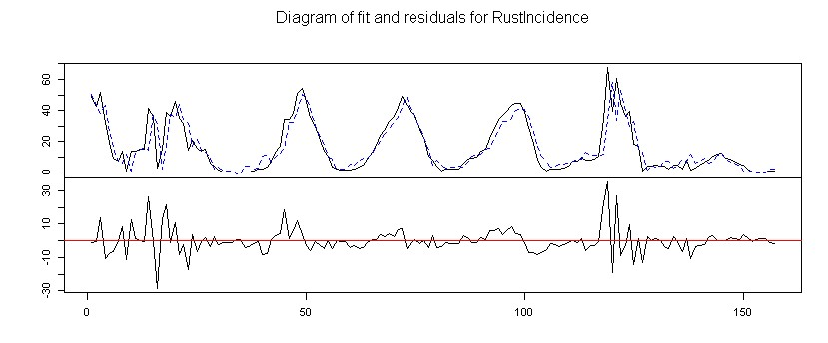
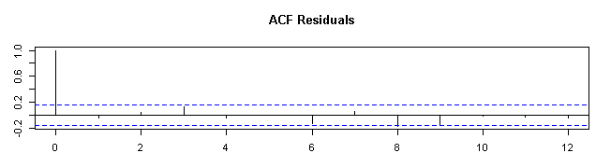
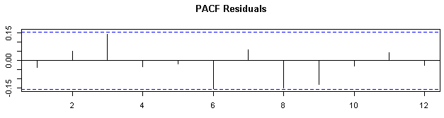
Department of Management Studies 5th Apr 2018 Indian Institute of Science

Slide 8
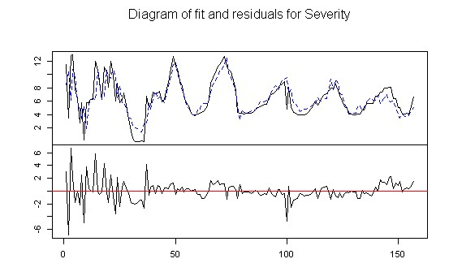
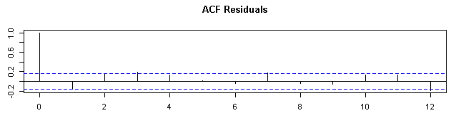
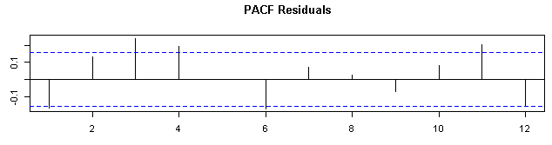
Department of Management Studies 5th Apr 2018 Indian Institute of Science

Slide 9
Interpretation of VAR output
Coefficients:
Its very difficult to interpret the coefficients of a VAR output, e.g. in the 8 variable system and we have a VAR of lag order 1 then there would be 8*8*1 = 64 coefficients.
Covariance matrix of residuals:
The covariance matrix will be of size 8*8.
So need to look at 28 covariances.
Granger causality:
Idea: A cause cannot come after effect. A process affects another process then the former should help improving the predictions of the latter.
Useful when we want to find out if a set of variables is Granger causing another set of variables.
It may not tell the complete story about the interactions between the variables of a system.
It surely tells if a set of variables contain useful information for improving the forecast of another set of variables.
Impulse response analysis:
It is of interest to find out the response in one variable to an impulse in another variable in a system.
If there is a reaction of one variable to an impulse in another variable in a system we can call the latter causal for the first.
Department of Management Studies 5th April 2018 Indian Institute of Science

Slide 10
Granger causality:
Variety A:
Variety C:
$Granger
H0: TempMax TempMin RelativeHumidity Sunshine RainFall do not Granger-cause Population Infected RustIncidence Severity
data: VAR object VarA
F-Test = 2.2692, df1 = 15, df2 = 1288, p-value = 0.003674
$Granger
H0: TempMax TempMin RelativeHumidity Sunshine RainFall do not Granger-cause Population Infected RustIncidence Severity
data: VAR object VarC
F-Test = 3.3586, df1 = 15, df2 = 1288, p-value = 1.365e-05
Variety B:
$Granger
H0: TempMax TempMin RelativeHumidity Sunshine RainFall do not Granger-cause Population Infected RustIncidence Severity
data: VAR object VarB
F-Test = 1.7349, df1 = 15, df2 = 1304, p-value = 0.03914
Department of Management Studies 5th April 2018 Indian Institute of Science

Slide 11
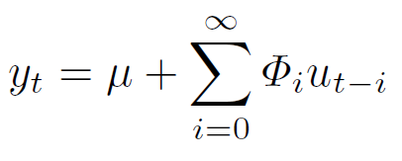

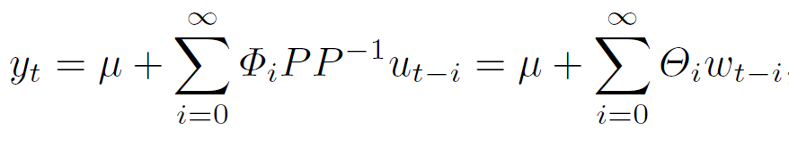



MA infinity representation of a stable VAR process:
Covariance matrix Cholesky decomposition:
Substitution:
where,
Covariance matrix:
This covariance matrix has:
Uncorrelated components
Unit variances – a unit innovation is just an innovation of size one SD.
Department of Management Studies 5th April 2018 Indian Institute of Science

Slide 12
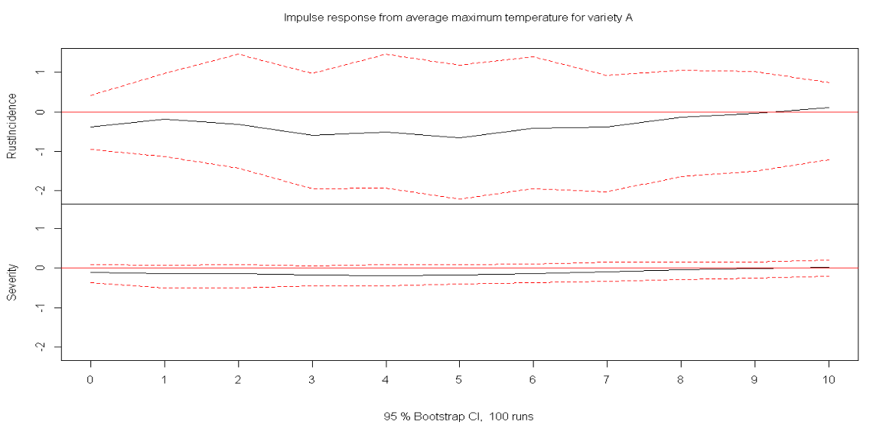
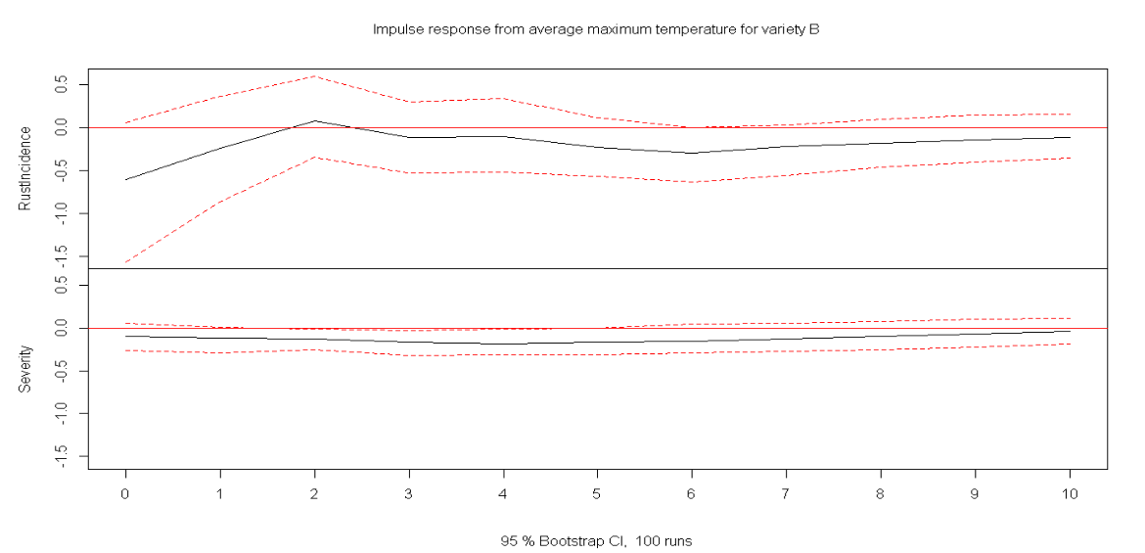
Impulse: Average maximum temperature
Department of Management Studies 5th April 2018 Indian Institute of Science

Slide 13
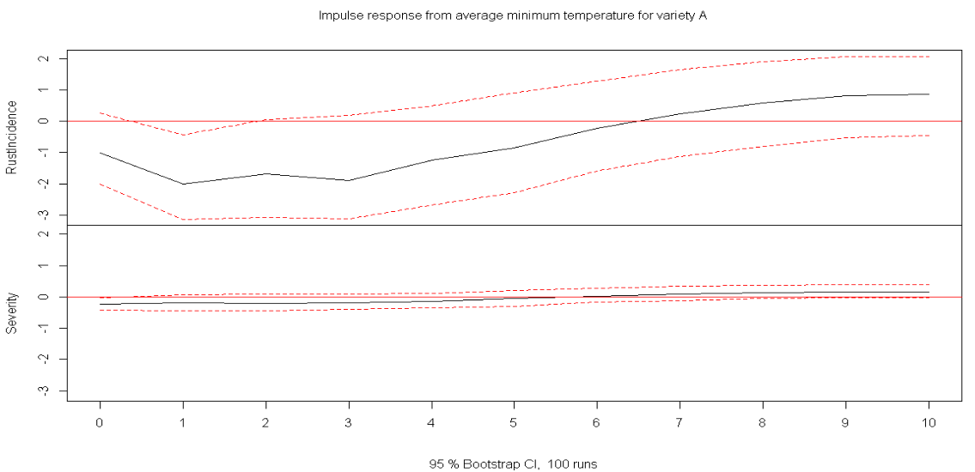
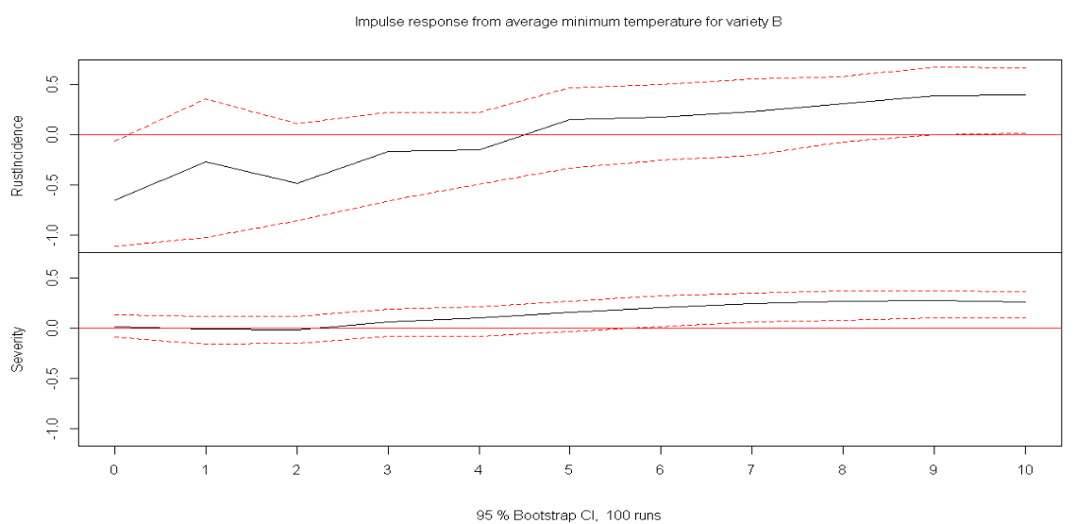
Impulse: Average minimum temperature
Department of Management Studies 5th April 2018 Indian Institute of Science

Slide 14
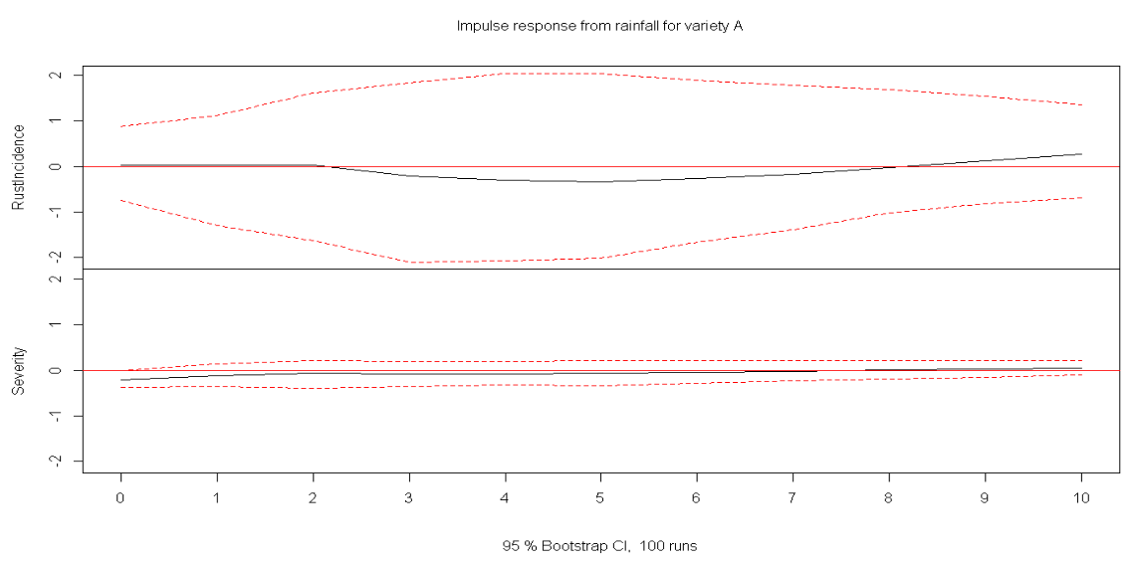
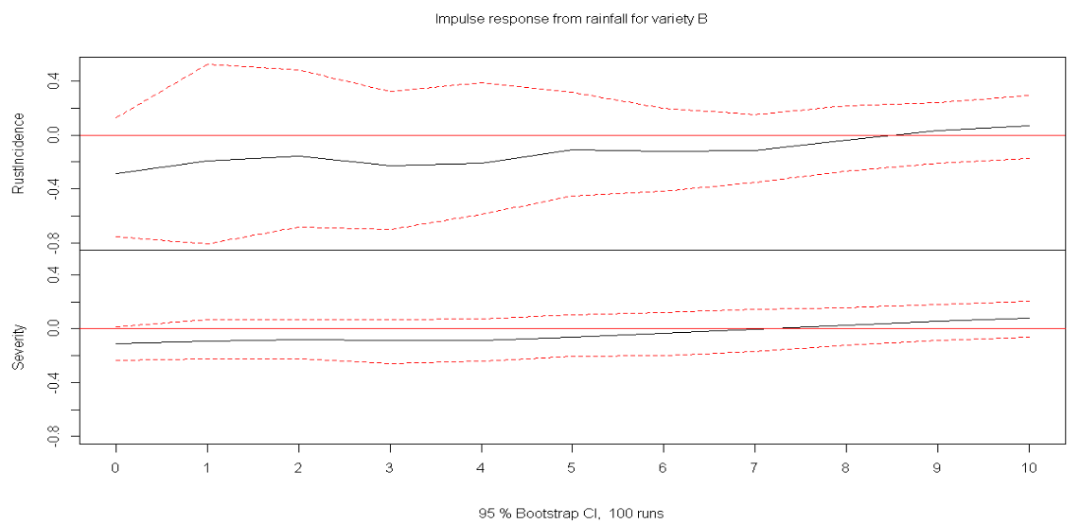
Impulse: Rainfall
Department of Management Studies 5th April 2018 Indian Institute of Science

Slide 15
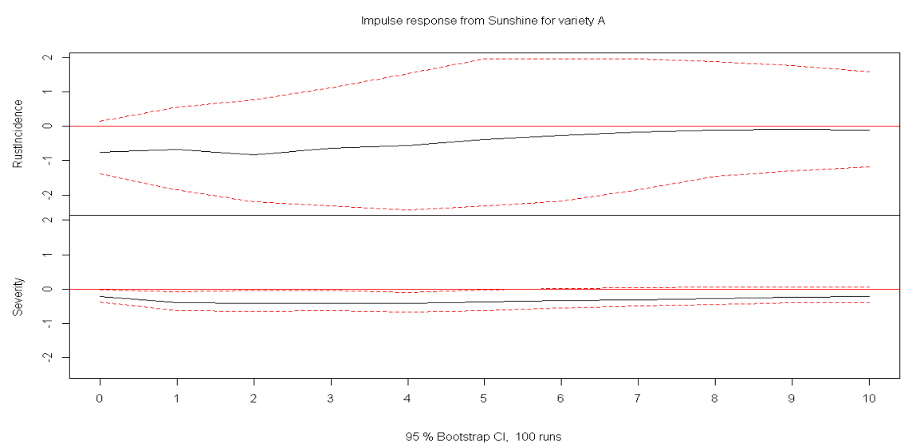
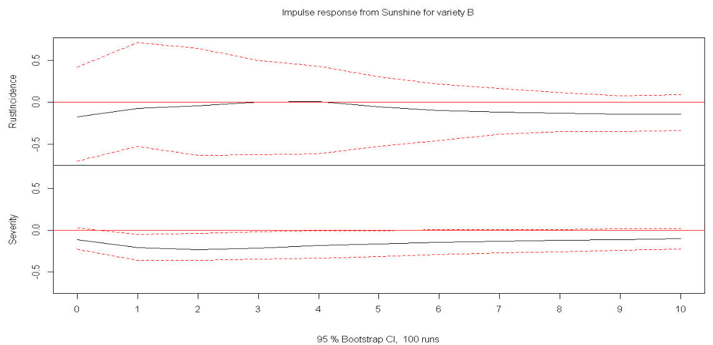
Impulse: Sunshine
Department of Management Studies 5th April 2018 Indian Institute of Science

Slide 16
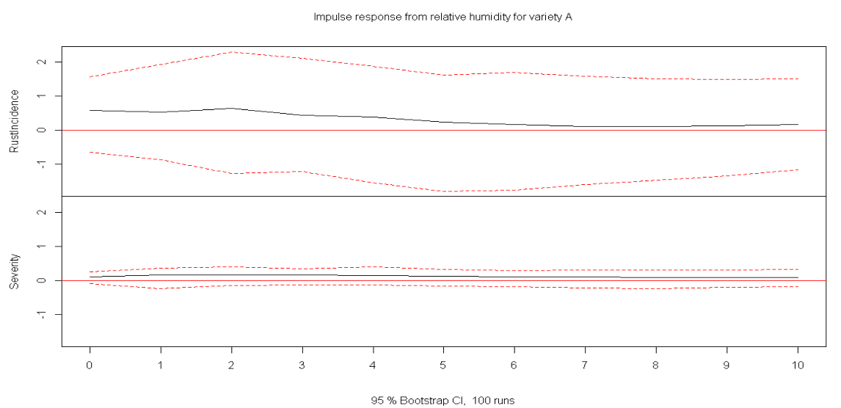
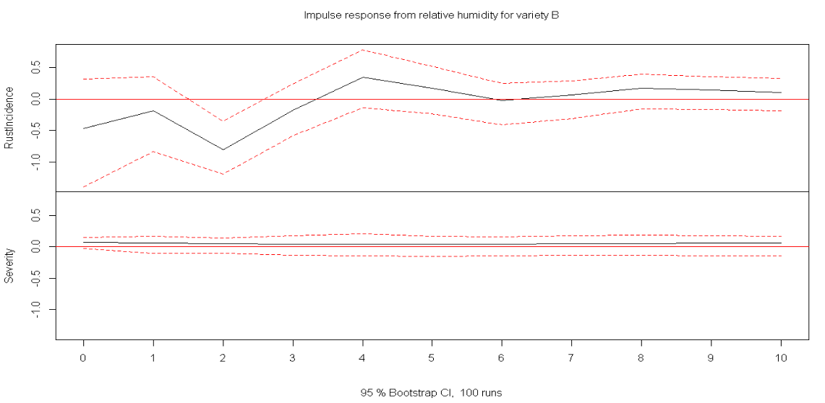
Impulse: Relative humidity
Department of Management Studies 5th April 2018 Indian Institute of Science

Slide 17
Accuracy from VAR model using the split – Train - 87% Test – (97-98)%
Variety | A
 |  | Rust Incidence | Severity
Accuracy Measures | Mean Absolute Error | 3.486947 | 3.971496
 | Mean Forecast Error | -3.486947 | -3.9715
 | Root mean squared error | 5.45317 | 5.628868
 | Mean absolute percentage error | 35.39893 | 39.69981
Variety | B | Rust Incidence | Severity
Accuracy Measures | Mean Absolute Error | 2.520432 | 2.022224
 | Mean Forecast Error | -2.520432 | -2.02222
 | Root mean squared error | 3.620831 | 2.950731
 | Mean absolute percentage error | 30.38446 | 24.24341
Variety | C | Rust Incidence | Severity
Accuracy Measures | Mean Absolute Error | 2.198001 | 1.075771
 | Mean Forecast Error | -2.198001 | -1.07577
 | Root mean squared error | 3.188518 | 1.642637
 | Mean absolute percentage error | 23.77836 | 11.49234
Department of Management Studies 5th April 2018 Indian Institute of Science

Slide 18
Machine learning models – Motivation:
There are numerous research papers that focus on prediction of coffee leaf rust using many machine learning techniques.
Some of the techniques that have been used are
Neural networks
Support vector machines
K-nearest neighbours
Logistic regression
Department of Management Studies 5th April 2018 Indian Institute of Science

Slide 19
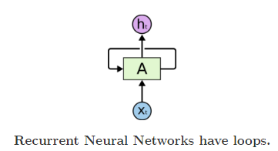
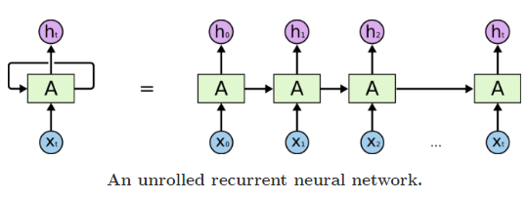
Idea: Thoughts have persistence. We don’t start thinking over from scratch again.
Recurrent Neural Networks.
What is it?
How does this work?
Why good for sequential data?
Unrolling a recurrent neural network:
Multiple copies of the same network.
Each passes some information to it’s successor.
Department of Management Studies 5th April 2018 Indian Institute of Science

Slide 20
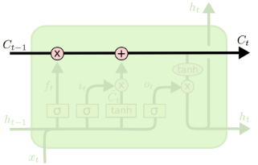
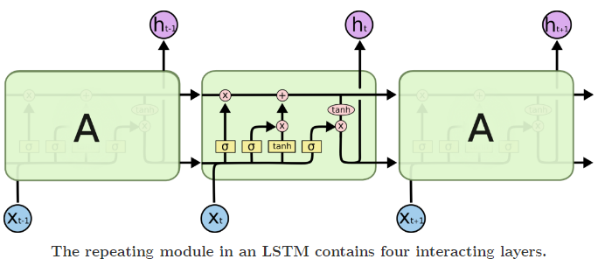

Long short term memory – LSTM
LSTM module:
Cell state:
Department of Management Studies 5th April 2018 Indian Institute of Science

Slide 21
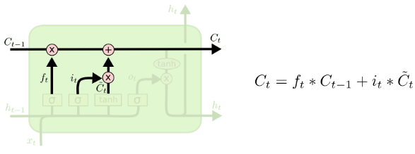
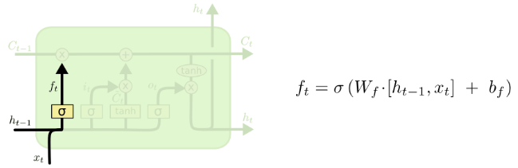
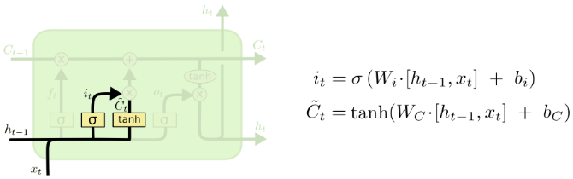
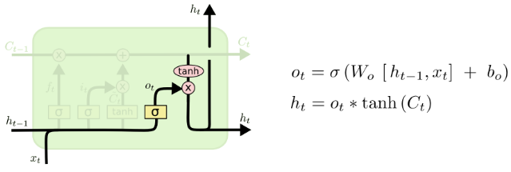
Input gates and cell update:
a)
c)
b)
d)
Department of Management Studies 5th April 2018 Indian Institute of Science

Slide 22
Road ahead.
Go through research papers focused on RNN for time series prediction.
Back propagation through time algorithm
Implementing RNN and LSTM
Comparing the accuracy of the Machine learning models with VAR model.
Project Report
Department of Management Studies 5th April 2018 Indian Institute of Science

Slide 23
References:
Lütkepohl, H. (2007) New Introduction to Multiple Time Series Analysis , Springer.
http://colah.github.io/posts/2015-08-Understanding-LSTMs/
Department of Management Studies 5th April 2018 Indian Institute of Science

Slide 24
Thank You!
Department of Management Studies 5th April 2018 Indian Institute of Science

Slide 25
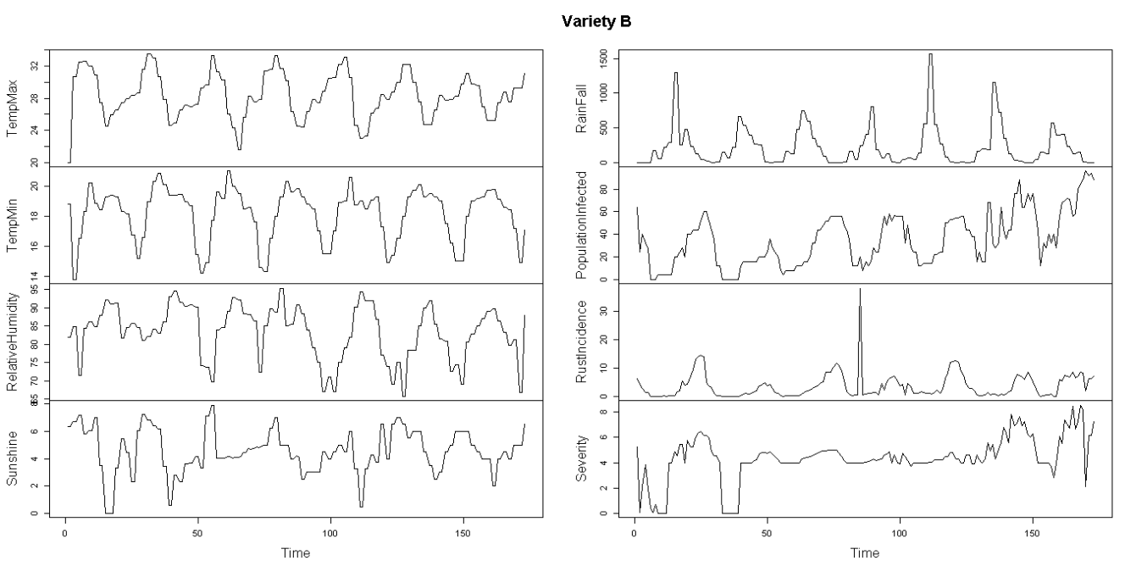
Time Series plots
Department of Management Studies 4th April 2018 Indian Institute of Science

Slide 26
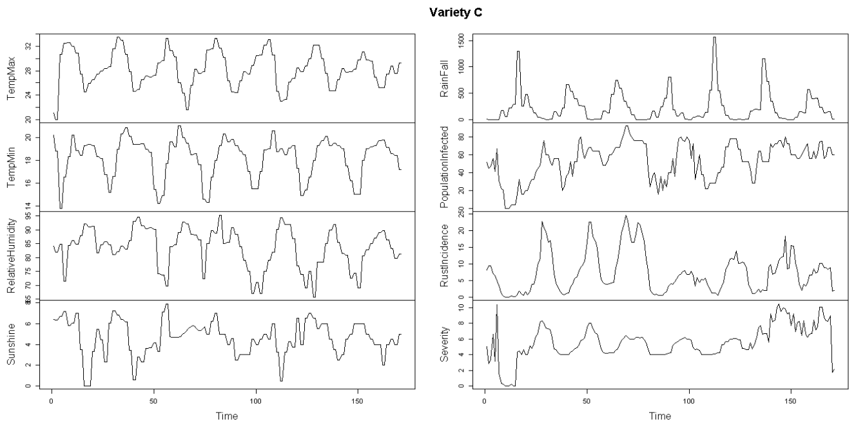
Time Series plots
Department of Management Studies 4th April 2018 Indian Institute of Science

Slide 27
Forecast error variance decomposition:
Variety C, Rust incidence FEVD
TempMax TempMin RelativeHumidity Sunshine RainFall PopulationInfected RustIncidence
[1,] 0.03073238 0.01439666 0.0009827808 0.009790388 0.001652832 0.05413397 0.8883110
[2,] 0.07177304 0.02156669 0.0019596653 0.007508073 0.018693844 0.06820915 0.8101820
[3,] 0.12085278 0.02177971 0.0055486141 0.005375347 0.034575944 0.07817895 0.7332476
[4,] 0.17043716 0.01853516 0.0103864561 0.004279562 0.044246690 0.08466700 0.6664526
[5,] 0.21544496 0.01537169 0.0159145689 0.004209560 0.047959155 0.08840020 0.6110015
Severity
[1,] 0.0000000000
[2,] 0.0001075623
[3,] 0.0004410299
[4,] 0.0009953484
[5,] 0.0016983225
Department of Management Studies 4th April 2018 Indian Institute of Science

